Slide 1
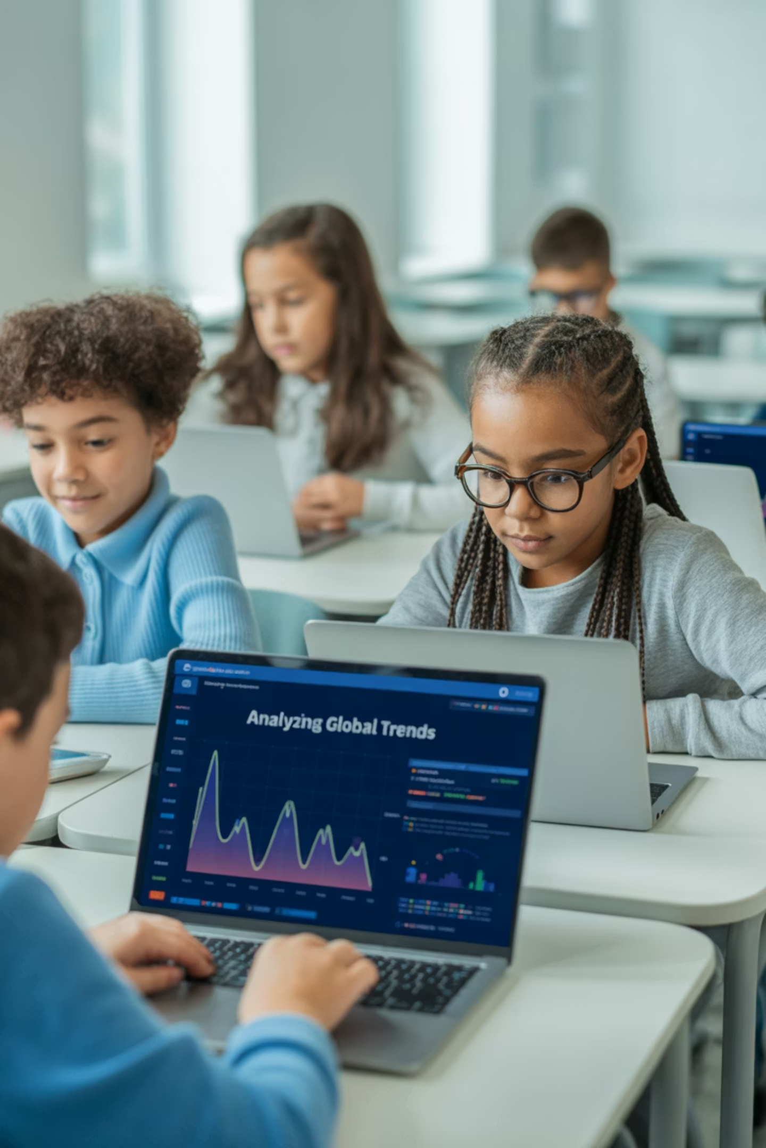
Introduction to Machine Learning: How Computers Learn from Data
Welcome to the exciting world where computers become smart learners, just like you! Today we'll discover how machines can learn patterns, make predictions, and solve problems by looking at examples.

Slide 2
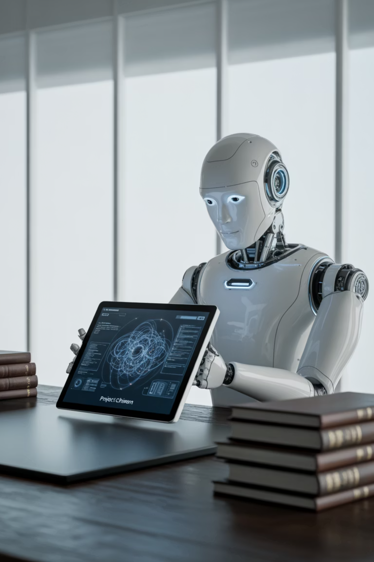
What is Machine Learning?
Learning from Examples
Machine Learning is when computers learn from examples instead of being told exactly what to do, just like how you learn to ride a bike through practice.
Pattern Recognition
Computers study lots of data to find patterns and make smart decisions, similar to how you recognize your friends' faces in a crowd.
Real-World Example
A music app learns your favorite songs by watching what you listen to, then suggests new music you might enjoy.

Slide 3
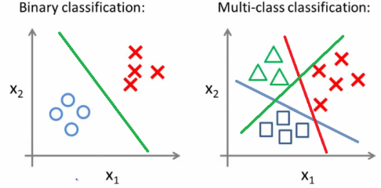
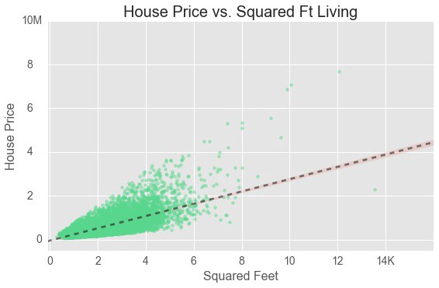
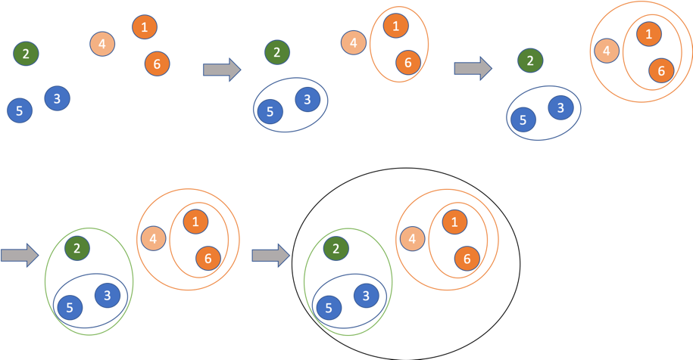
Types of Algorithms
Classification
Regression
Clustering

Slide 4
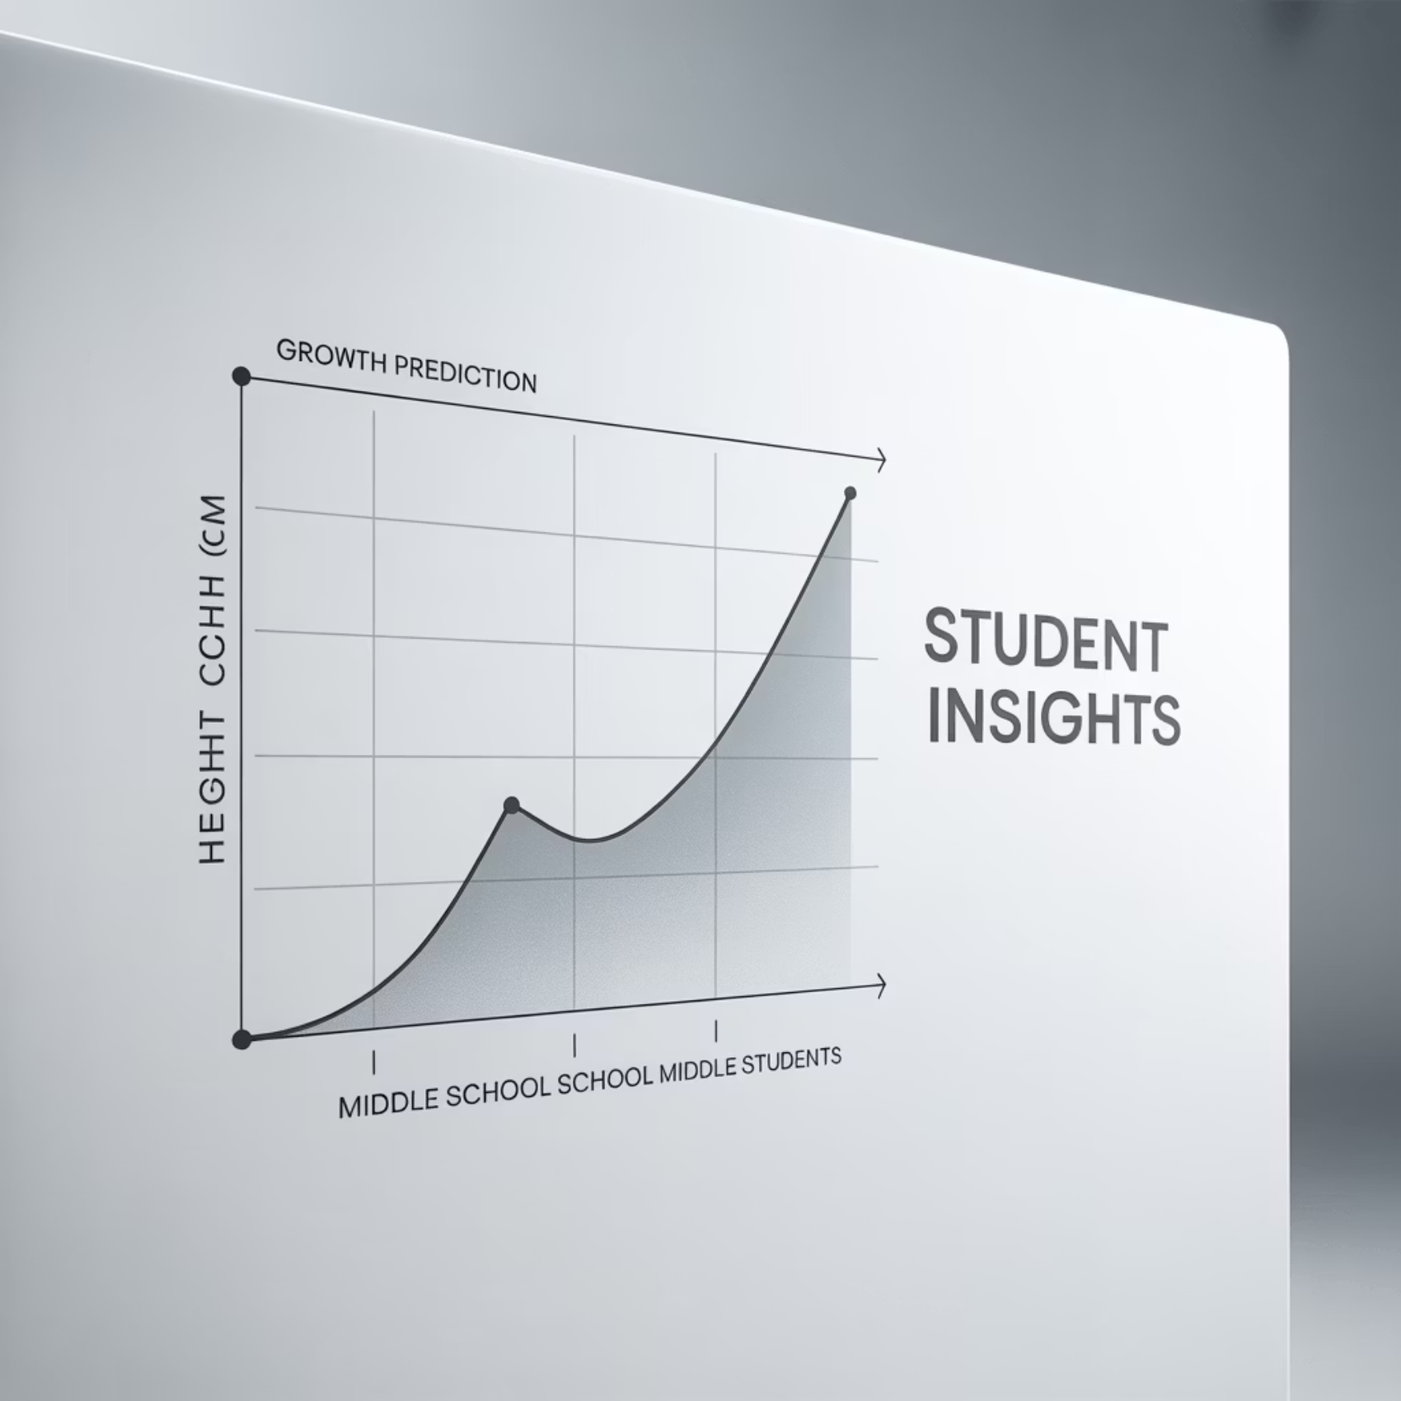
Concept 1: Regression — Predicting Numbers
What is Regression?
Regression helps computers predict a number based on information they already know. It's like being a fortune teller, but using math instead of a crystal ball!
How It Works
Imagine drawing a line through points on a graph to guess where the next point should be. That's exactly what regression does with data.
Example: Predicting how tall you'll be next year based on your current height, age, and how much you've grown before.

Slide 5
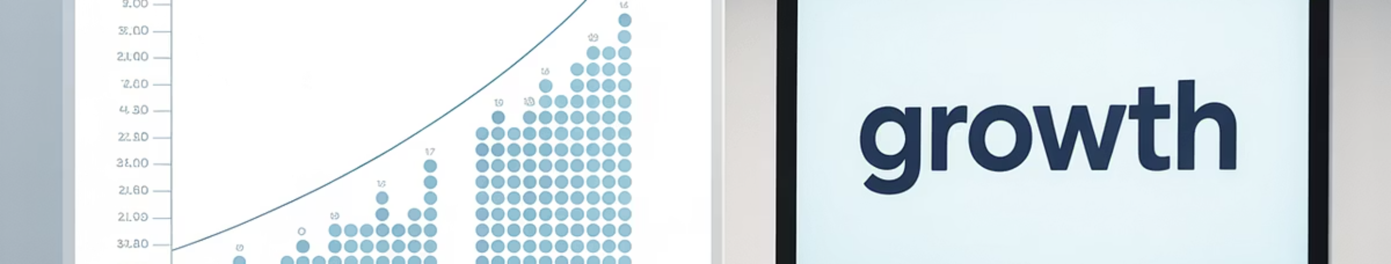

Visual Example: Regression
The Data Points
The Prediction Line
Each dot represents a student's age and height. Notice how they form a pattern going upward?
The line shows the pattern and helps predict future heights. Regression finds the best line through all the points.
Regression predicts numbers by finding patterns in existing data, like drawing the perfect line through scattered points!

Slide 6




Concept 2: Classification — Sorting into Groups
Putting Things in Categories
Real Example
Classification helps computers put things into specific groups or categories, like organizing your backpack.
Sorting emails into "Spam" or "Not Spam" - the computer learns what spam looks like and sorts new emails automatically.
Think of It Like
Sorting your toys into boxes: cars in one box, dolls in another, games in a third box.

Slide 7
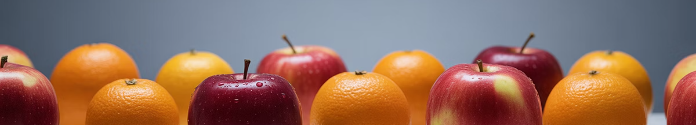


Visual Example: Classification
Look at the Features
Make the Decision
Color, shape, size, texture - the computer learns what makes an apple different from an orange.
Based on these features, the computer sorts each new fruit into the right category.
Classification sorts things into groups by learning the differences between categories!

Slide 8






Concept 3: Clustering — Finding Groups Without Labels
Natural Grouping
Like how friend groups form naturally based on shared interests - no one tells you which group to join!
No Labels Needed
Clustering groups things that are similar, even when we don't know what the groups should be beforehand.
Hidden Patterns
The computer discovers hidden patterns and groups things together that share similar characteristics.

Slide 9

Visual Example: Clustering
The Mystery Groups
Notice how the dots naturally form separate groups? The computer found these groups without being told what to look for!
Similar Things Together
Each color represents things that are similar to each other. Clustering reveals patterns we might not have noticed.
Clustering finds hidden groups in data!

Slide 10




Why Does Machine Learning Matter?
Entertainment
Recommending videos you'll love on YouTube, suggesting new games, and finding music that matches your taste.
Recognition
Recognizing faces in photos, translating languages instantly, and helping doctors detect diseases earlier.
Transportation
Self-driving cars that can navigate safely, and apps that find the fastest route to school.
Machine Learning is all around us, making technology smarter and more helpful every day!

Slide 11
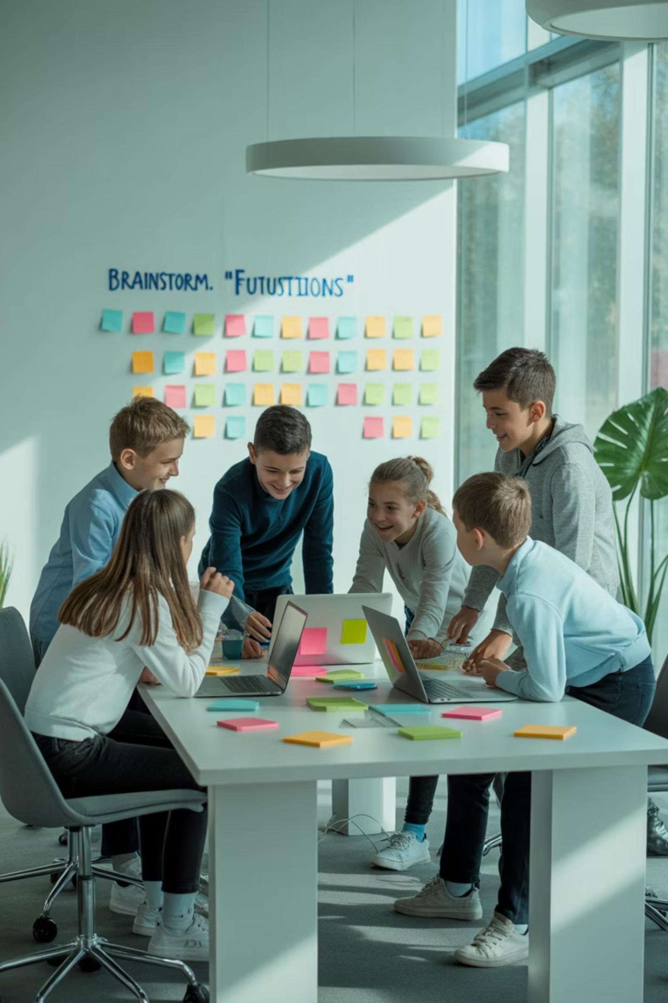



Your Turn to Explore!
Think Creatively
What would you want a computer to learn? Maybe predicting which pizza toppings your friends will like?
Choose Your Challenge
Pick something to predict (regression), sort (classification), or group (clustering). The possibilities are endless!
Start Your Journey
Machine Learning is like teaching a computer to be curious and smart — just like you! Every great AI started with someone asking "what if?"
Remember: You have the power to teach machines to make the world a better place!

